Slide 1
REACT COURSE OUTLINE
Designed By :- Ahtesham Akram

Slide 2
DAY 01
Introduction To Modern React JS
React Dev Tools
Folder Structure in React JS
Concept of Virtual DOM

Slide 3
INTRODUCTION TO MODERN REACT JS
Why React ?
React is a JavaScript library for building user interfaces. React was first created by Jordan Walke, a software engineer at Facebook. It was incorporated into Facebook’s newsfeed in 2011 and later on Instagram when it was acquired by Facebook in 2012. At JSConf 2013, React was made open source, and it joined the crowded category of UI libraries like jQuery, Angular, Dojo, Meteor, and others

Slide 4
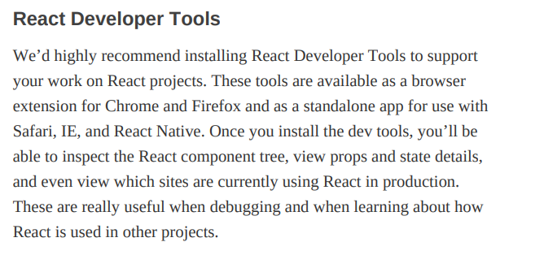

Slide 5
Virtual DOM
Virtual DOM:-
The virtual DOM (VDOM) is a programming concept where virtual representation of a UI is kept in memory. So for every object that exists in the original DOM, there is an object for that in React Virtual DOM. It is exactly the same, but it does not have the power to directly change the layout of the document. Manipulating DOM is slow, but manipulating Virtual DOM is fast as nothing gets drawn on the screen. So each time there is a change in the state of our application, the virtual DOM gets updated first instead of the real DOM

Slide 6
Folder Structure:-
It will demonstrate in VS Code

Slide 7
DAY 02
Component, class & Functional Components
A closer look at JSX Code
Styling approaches in React

Slide 8

A closer look at JSX
JSX:-
JSX stands for Javascript XML . It is a special type of syntax use in react components.

Slide 9

Components
Components:-
Conceptually, components are like JavaScript functions. They accept arbitrary inputs (called “props”) and return React elements describing what should appear on the screen.
This approach of creating component called Functional Component

Slide 10
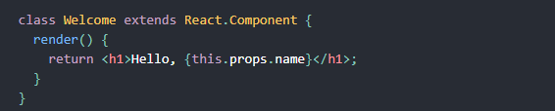
This approach of creating component called Class Component

Slide 11
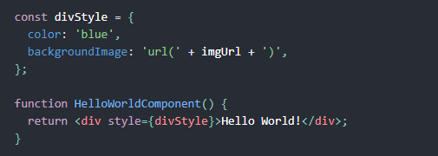
Style Our Components
For styling, you can use mainly three approaches. Inline, External, using any third party packages.
Inline Styling:-

Slide 12
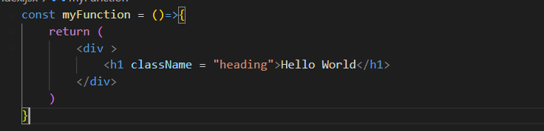
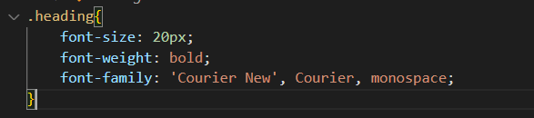
External CSS:-

Slide 13
DAY 03
State & Props
Conditional Rendering
Project:- Implementation of UI Design with ReactJS

Slide 14

What is State ?
State:-
State is a special type of variable in React which update on realtime on the virtual DOM as compared to the normal javascript variable. For using this React provides us a hook called useState().

Slide 15
Class Task:-
Create a Counter Application using State

Slide 16

What is Props ?
Props:-
React props are like function argument in javascript. Props get passed to the component (similar to function parameters) where state is managed within the component (similar to variables declared within a function )

Slide 17
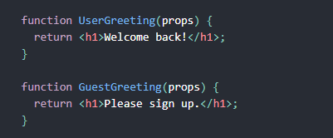
What is Conditional Rendering ?
Conditional Rendering:-
Conditional Rendering works the same way just like condition work in JS. Use JS operators like if to create elements representing the current state and let React update the UI to match them
For Eg:-

Slide 18
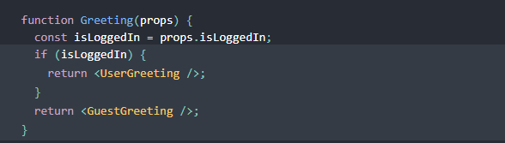

Slide 19
Project :- Implement UI Design using ReactJS

Slide 20
DAY 04-05
Hooks
Events
Fragments

Slide 21
What are Hooks ?
Hooks:-
A Hook is a special function that lets you perform some special tasks. They are start from the keyword use . Just like we studied useState() in a previous lecture.
Note:-
Don’t call Hooks inside loops, conditions, or nested functions. Instead, always use Hooks at the top level of your React function,

Slide 22
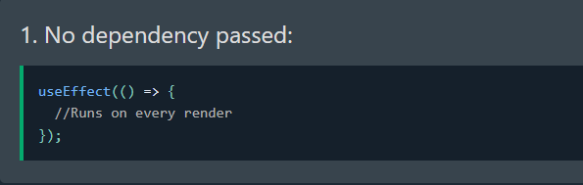
useEffect()
The useEffect() Hook allows you to perform side effects in your component. Some examples of side effects are: fetching data, updating DOM directly, timers etc. It takes two arguments: function & dependency array (optional). It has three cases

Slide 23
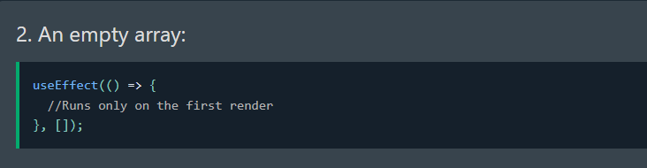
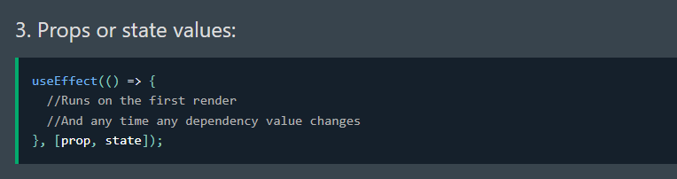

Slide 24
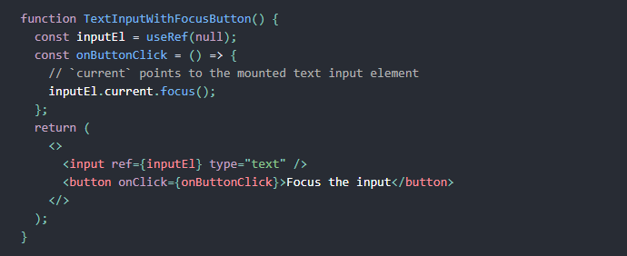
useRef()
Refs are a special attribute that are available on all React components. They allow us to create a reference to a given element / component. They works same as we worked in JS to target the DOM elements

Slide 25
Events Handling ?
onChange:-
The onChange event in React detects when the value of an input element changes.
onClick:-
onClick event handler enables you to call a function and trigger an action when a user clicks an element, such as a button, in your app
onSubmit:-
onSubmit event handler attached to the form submission event. The onsubmit attribute fires when a form is submitted.

Slide 26
React Fragment ?
React Fragment:-
React Fragment is a feature in React that allows you to return multiple elements from a React component by allowing you to group a list of children without adding extra nodes to the DOM. To return multiple elements from a React component, you'll need to wrap the element in a root element.

Slide 27
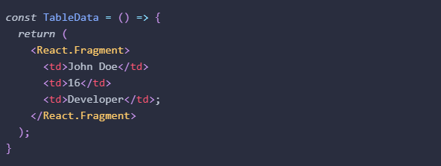
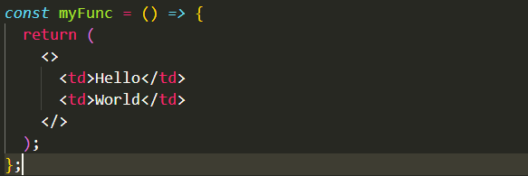
OR

Slide 28
DAY 06-07
Asynchronous Programmming
API Integration
Project:- Implementation of UI Design with ReactJS

Slide 29
What is Asynchronous ?
Asynchronous Programming:-
In computer programming, asynchronous operation means that a process operates independently of other processes, whereas synchronous operation means that the process runs only as a result of some other process being completed or handed off.

Slide 30
What is API Integration ?
API :-
API stands for (Application Programming Interface). APIs are mechanisms that enable two software components to communicate with each other using a set of definitions and rules called Protocol. It is basically a request that perform communication between client side and server side .

Slide 31
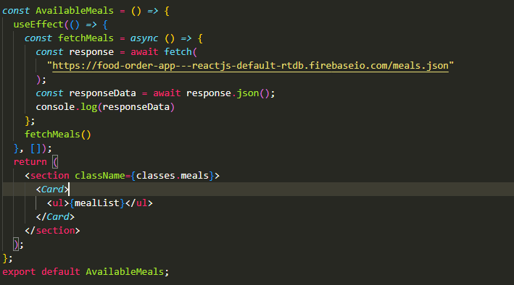
API INTEGRATION:-

Slide 32
DAY 08-09
Routing
Public, Private, Nested, Dynamic Routing
Project:- Ecommerce Web App with API Integration & Routing

Slide 33
What is Routing ?
ROUTING :-
In web application, Routing is a process of binding a web URL to a specific resource in the web application. In React, it is binding an URL to a component. We use a third party library called React Router DOM for implementing Routing.
Installation of React Router DOM:-
npm i react-router-dom

Slide 34
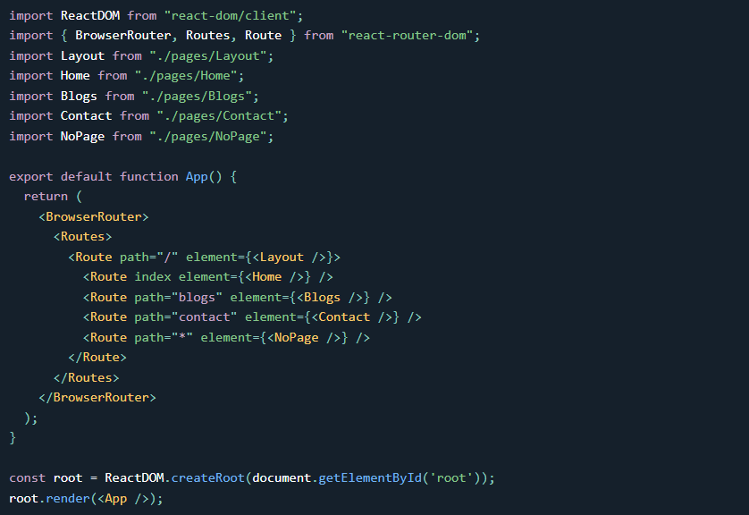
Syntax:-

Slide 35
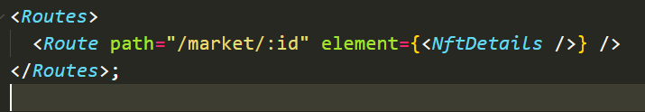
Dynamic Routing:-

Slide 36
Project:-
Ecommerce Web App with API Integration

Slide 37
DAY 10-11 &12
Context API
Redux
Project:- Convert previous Website on Redux
Deployment React Apps

Slide 38
What is Context API ?
Context API :-
Context is a built-in API introduced in ​​React 16.3. It makes it possible to pass data from parent to children nested deep down the component tree directly, instead of passing it down through a chain of props. It consist of the following three steps
Creating a context
Provider
Consumer

Slide 39

Creating a context:-
Provider:-

Slide 40
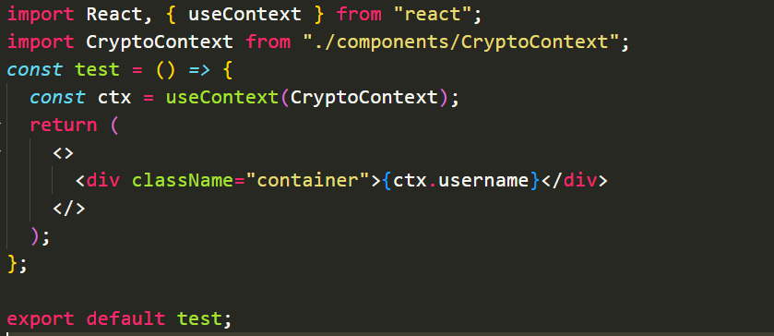
Consumer:-

Slide 41
What is Redux & why we use this ?
Redux :-
Redux is a state management library which is used to manage global state of the application. Global state means the states which are not limited to the component where was created, but accessible throught the application.

Slide 42
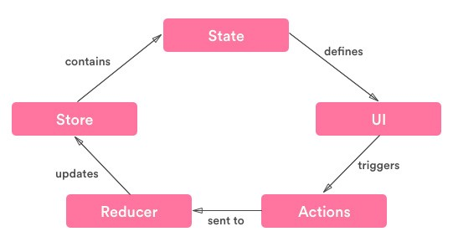
Redux Workflow
Practical Implementation will be in class

Slide 43
. Project:-
Convert previous Website on Redux
. Deploy React Apps

Slide 44
Thank You !

